Slide 1



41
April 2024

Slide 2
What are “Peering Personals”?
Chance for everyone to introduce their networks :)
The Community gets a chance to build a better-connected Internet …
“One Peering session at a time!”
41

Slide 3
How to prepare your Peering Personals slide/s
1. Select your template/s based on your category, eg ISP/OTT/CDN/Research/IXP/DC/transport
2. Fill-up the details (refer to examples) and save as
Filename format: Peering personal_<ISP/OTT/CDN/Research/IXP/DC name>_<ASN or category>.pptx
Templates : ISP/OTT/CDN Peering personal .pptx
RESEARCH Peering personal.pptx
IXP Peering personal.pptx
Data Center Peering personal.pptx
TRANSPORT Peering personal_Globe.pptx (Few Sample enclosed)
3. Submit at the Call For Papers (CFP) link : (https://papers.apnic.net/user/login.php?event=190)
4. Wait for the confirmation from the Program Committee (PC), if approved :)
Notes:
Presentation(talk) time is limited to “One(1) minute” only
Intended for “In-Person presentation only”, No Online Peering Personals
Deadline of submissions on 5th April 2024
Check the SANOG41 program for the Schedule (https://www.sanog.org/sanog41/)
Please submit only one slide as per your category
41

Slide 4
Peering Personals Template guide
1. ISP/OTT/CDN/Research; WHO to Peer
Basic information of Network Operators to establish peering ( ASN, Policy, location, etc)
2. Internet eXchange Point(IXP); WHERE to Peer
IXP information (name, location, peers, etc) as reference to peering
3. Data Center(DC); WHERE (location) to peer
DC information(name, location, etc) that hosts Peers, IXPs and transport providers
4. Transport; HOW to get there
Network information to enable physical connectivity to Peers, IXPs and DCs to establish peering
41

Slide 5
ISP/OTT/CDN
<Company>
<Company logo>
ASN | <XXX>
Traffic Profile | Content / Eyeballs / Balanced
Traffic Volume | <xbps>
Peering Policy | Open / Selective / Restrictive
Peering Locations | (IXP/ DC/Location) Indicate especially Asia and Oceana
Peeringdb Entry | asxxx.peeringdb.com
Contact Information | <name>, email <peering@domain.com>
optional
photo
Name
Additional updates/Message (if any)
41

Slide 6
RESEARCH
<Company>
<Company logo>
ASN | <XXX>
Traffic Profile | Educational / Research
Traffic Volume | <xbps>
Peering Policy | Open / Selective / Restrictive
Peering Locations | (IXP/ DC/Location) Indicate especially Asia and Oceana
Peeringdb Entry | asxxx.peeringdb.com
Contact Information | <name>, email <peering@domain.com>
optional
photo
Name
Additional updates/Message (if any)
41

Slide 7

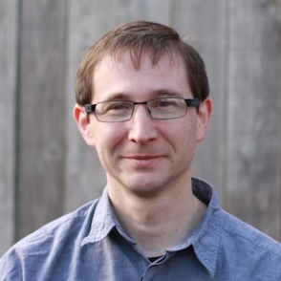
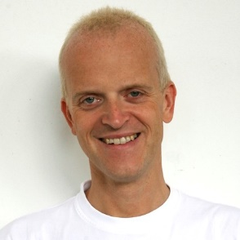
RESEARCH
Route Views
ASN | 6447
Traffic Profile | Educational / Research
Traffic Volume | Under 100Mbps
Peering Policy | Open
Peering Locations | 40+ IXes around the world
Peeringdb Entry | https://as6447.peeringdb.com
Contact Information | John Kemp, Hans Kuhn, Philip Smith <help@routeviews.org>
Sample
Hans
Philip
Additional updates/Message (if any)
41

Slide 8
IXP
<Company>
<Company logo>
IXP Name/s | <Name1> | <Name2>
Location | <City, Country> | <City, Country>
Point of Presence | <Data Center> | <Data Center>
# of connected ASNs | <count> | <count>
Peak Traffic | <xbps> | <xbps>
Route Server | No/Yes <BIRD/OpenBGPD/etc> | No/Yes <BIRD/OpenBGPD/etc>
Peeringdb/IXPdb | https://www.peeringdb.com/ix/xx | https://www.peeringdb.com/ix/xx
optional
photo
Contact Person/s
Contact information
Additional updates/Message (if any)
41

Slide 9

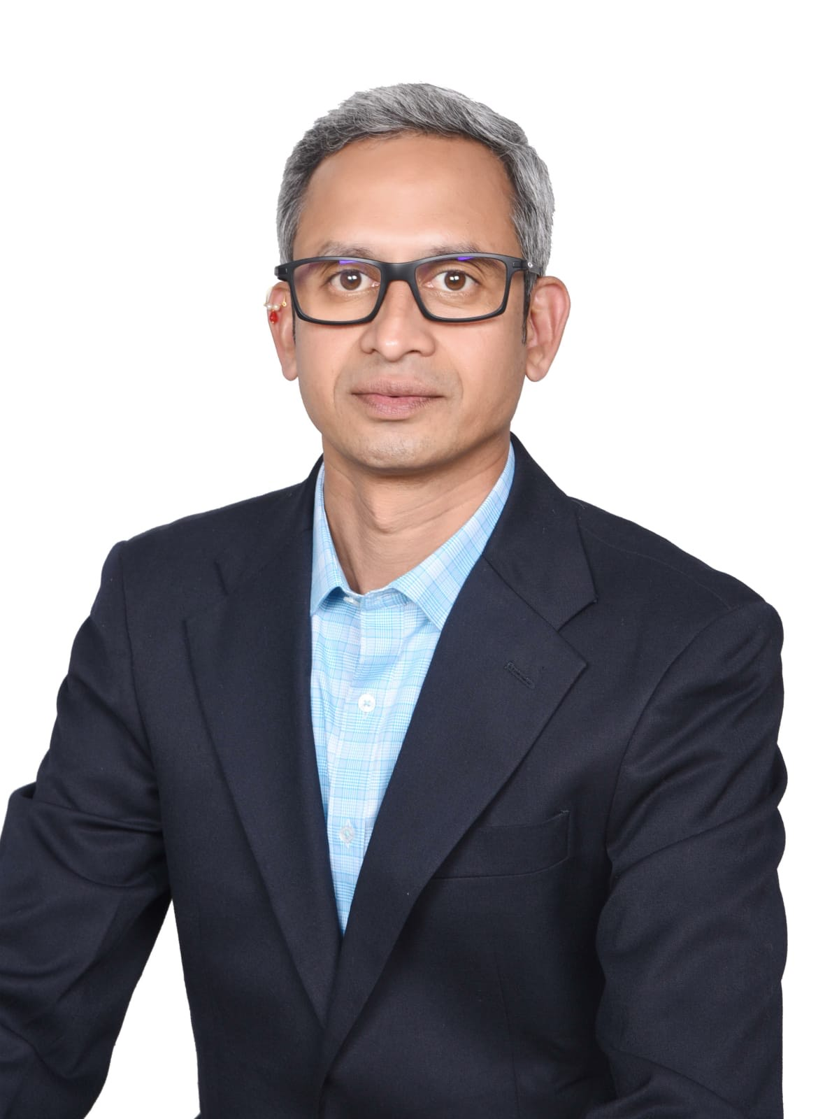
IXP
DE-CIX
IXP Name/s | DE-CIX ASIA Distributed Exchange https://www.peeringdb.com/org/26904
Location | Malaysia, Singapore, Brunei, Manila, Indonesia (Coming Soon)
Point of Presence | Suntech Cybercity Penang AIMS Kuala Lumpur CJ1, CX1, CX02, PLT Pro Cyberjaya Menara MSC Cyberport, Menara Ansar Johor Bahru Globalswitch, Equinix SG1 Singapore Tungku Submarine Cable Station Brunei ePLDT VITRO Makati
# of connected ASNs | 81
Peak Traffic | 84.53 Gbit/s
Route Server | Yes, https://www.de-cix.net/en/asia/route-server-guide
Peeringdb/IXPdb | https://www.peeringdb.com/ix/3472
Sample
Sushil Kulkarni
Contact Info :
sushil.kulkarni@de-cix.net
41

Slide 10
Data Center
<Company>
<Company logo>
Data Center | <Name1> | <Name2>
Location | <City, Country> | <City, Country>
IXP Presence | <IXPs> | <IXPs>
Colocators: ASN presence | <Colocator count> | <Colocator count>
Subsea cables presence/access | <Landed / Extended> | <Landed / Extended>
DC specification (Rack, Floor space, Power) | <rack count /util, Floor space max power> | <rack count /util, Floor space max power>
DC URL reference | DC website | DC website
DC to DC Interconnection | <DCs with interconnection & type> | <DCs with interconnection & type>
Peeringdb | <https://www.peeringdb.com/fac/xxx> | <https://www.peeringdb.com/fac/xxx>
optional
photo
Contact Person/s
Contact information
41
Additional updates/Message (if any)

Slide 11
TRANSPORT
<Company>
<Company logo>
City/Country | <City, Country> | <City, Country>
Facility Presence | <DC locations> | <DC locations>
Facility Type | <DWDM, Dark Fiber, etc> | <DWDM, Dark Fiber, etc>
Bandwidth Options | <xbps range> | <xbps range>
Subsea Cables | <subsea cables - owned capacities> | <subsea cables - owned capacities>
Website | <reference website> | <reference website>
optional
photo
Contact Person/s
Contact information
Additional updates/Message (if any)
41

Slide 12
PEERING
MEANS BEING PART OF A WHOLE INTERCONNECTION ECOSYSTEM
41

