Slide 2
What are “Peering Personals”?
Chance for everyone to introduce their networks ☺
The community gets a chance to build a better connected Internet …
“One Peering session at a time!”

Slide 3
How to prepare your Peering Personals slide/s ☺
1. Select your template/s based on your category, eg ISP/OTT/CDN/Research/IXP/DC/transport
2. Fill-up the details (refer to examples) and save as
Filename format: Peering personal_<ISP/OTT/CDN/Research/IXP/DC name>_<ASN or category>.pptx
Example: Peering personal_Globe_4775.pptx
Peering personal_GIX_IXP.pptx
Peering personal_Globe_DC.pptx
Peering personal_Globe_Transport.pptx
Peering personal_Globe.pptx (if for multiple templates)
3. Submit at the Call For Papers (CFP) link : (https://papers.sanog.org/user/login.php?event=173)
4. Wait for the confirmation from the Program Committee (PC), if approved ☺
Notes:
Presentation(talk) time is limited to “One(1) minute” only
No Online Peering Personals

Slide 4
Peering Personals Template guide ☺
1. ISP/OTT/CDN/Research; WHO to Peer
Basic information of Network Operators to establish peering ( ASN, Policy, location, etc)
2. Internet eXchange Point(IXP); WHERE to Peer
IXP information (name, location, peers, etc) as reference to peering
3. Data Center(DC); WHERE (location) to peer
DC information(name, location, etc) that hosts Peers, IXPs and transport providers
4. Transport; HOW to get there
Network information to enable physical connectivity to Peers, IXPs and DCs to establish peering
Peering Connectivity reference
2
1
4
3
1

Slide 5
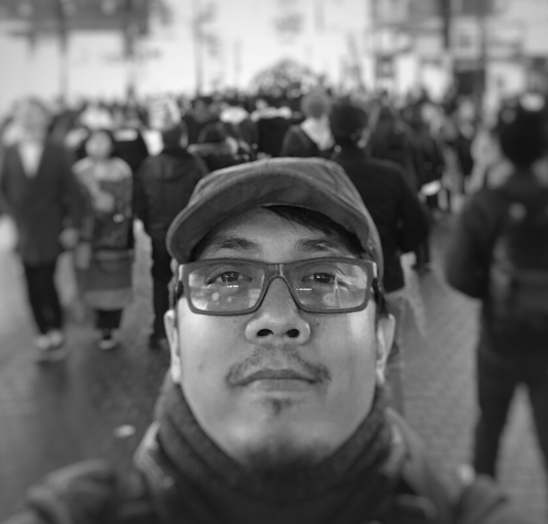
ISP/OTT/CDN
<Company>
<Company logo>
ASN | <XXX>
Traffic Profile | Content / Eyeballs / Balanced
Traffic Volume | <xbps>
Peering Policy | Open / Selective / Restrictive
Peering Locations | (IXP/ DC/Location) Indicate especially Asia and Oceana
Peeringdb Entry | asxxx.peeringdb.com
Contact Information | <name>, email <peering@domain.com>
optional
photo
Name

Slide 6
ISP/OTT/CDN
Globe Telecom
ASN | 4775
Traffic Profile | Eyeballs
Traffic Volume | 6Tbps+
Peering Policy | Open
Peering Locations | 25 locations : US, Asia(JPN, HKG, SNG, PHL) EU (remote Peering)
Peeringdb Entry | as4775.peeringdb.com
Contact Information | Achie Atienza - vbatienza@globe.com.ph peering@globe.com.ph
Sample
Achie

Slide 7
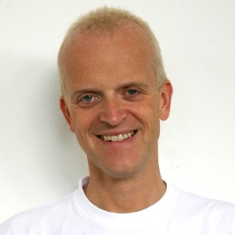
RESEARCH
<Company>
<Company logo>
ASN | <XXX>
Traffic Profile | Educational/Research
Traffic Volume | <xbps>
Peering Policy | Open / Selective / Restrictive
Peering Locations | (IXP/ DC/Location) Indicate especially Asia and Oceana
Peeringdb Entry | asxxx.peeringdb.com
Contact Information | <name>, email <peering@domain.com>
optional
photo
Name

Slide 8
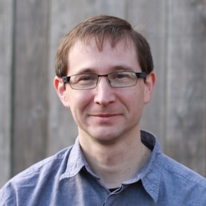
RESEARCH
RouteViews
ASN | 6447
Traffic Profile | Educational/Research
Traffic Volume | Under 100Mbps
Peering Policy | Open
Peering Locations | >36 IXes around the world
Peeringdb Entry | https://as6447.peeringdb.com
Contact Information | John Kemp, Hans Kuhn, Philip Smith <help@routeviews.org>
Sample
Hans
Philip

Slide 9
IXP
<Company>
<Company logo>
IXP Name/s | <name1> | <name2>
Location | <City, Country> | <City, Country>
Point of Presence | <Data Center> | <Data Center>
# of connected ASNs | <count> | <count>
Peak Traffic | <xbps> | <xbps>
Route Server | No/Yes <BIRD/OpenBGPD/etc> | No/Yes <BIRD/OpenBGPD/etc>
Peeringdb/IXPdb | https://www.peeringdb.com/ix/xx | https://www.peeringdb.com/ix/yy
optional
photo
Contact Person/s
Contact information

Slide 10
IXP
Globe IX (GIX)
IXP Name/s | GIX | GIX Cebu | GIX Davao / Quezon City
Location | Makati, Philippines | Cebu, Philippines | Davao & Quezon City, Ph
Point of Presence | Globe MK2 | Globe CB1 | Globe DV1 & QC2
# of connected ASNs | 16 | Ongoing TBD | Ongoing TBD
Peak Traffic | 64Gbps+ | Ongoing TBD | Ongoing TBD
Route Server | Yes | Ongoing TBD | Ongoing TBD
Peeringdb / IXPdb | https://www.peeringdb.com/ix/317 | https://www.peeringdb.com/ix/3589 | TBD
Sample
Achie Atienza
vbatienza@globe.com.ph
peering@globe.com.ph

Slide 11
DATA CENTER
<Company logo>
<Company>
Data Center | <name1> | <name2>
Location | <City, Country> | <City, Country>
IXP Presence | <IXPs> | <IXPs>
Colocators: ASN presence | <Colocator count> | <Colocator count>
Peeringdb | <https://www.peeringdb.com/fac/xxx> | <https://www.peeringdb.com/fac/xxx>
optional
photo
Contact Person/s
Contact information

Slide 12
DATA CENTER
Globe Telecom
Data Center | Globe MK2 | Globe CB1 | Globe DV1 | Globe QC2
Location | Makati, Philippines | Cebu, Philippines | Davao, Philippines | Quezon City,Philippines
IXP presence | GIX, PhOpenIX, GETAFIX | GIX | GIX (soon) | GIX (soon)
Colocators: ASN presence | 10 (ongoing update) | 1 (ongoing update) | 1 (ongoing update) | (ongoing update)
Peeringdb | https://www.peeringdb.com/fac/10852 | https://www.peeringdb.com/fac/10853 | https://www.peeringdb.com/fac/11634 | https://www.peeringdb.com/fac/11118
Sample
Achie Atienza
vbatienza@globe.com.ph
peering@globe.com.ph

Slide 13
TRANSPORT
<Company logo>
<Company>
City/Country | <City, Country> | <City, Country>
Facility Presence | <DC locations> | <DC locations>
Facility Type | <DWDM, Dark Fiber, etc> | <DWDM, Dark Fiber, etc>
Bandwidth Options | <xbps range> | <xbps range>
Subsea Cables | <subsea cables - owned capacities> | <subsea cables - owned capacities>
Website | <reference website> | <reference website>
Sample
Contact Person/s
Contact information
optional
photo

Slide 14
TRANSPORT
Globe Telecom
City/Country | Metro Manila, Philippines | Cebu & Davao, Philippines
Facility Presence | Globe, PLDT, ETPI, TIM, DOST-ASTI, DCs | Globe, PLDT DCs
Facility Type | DWDM, Dark Fiber(per requirement basis) | DWDM, Dark Fiber(per requirement basis)
Bandwidth Options | Sub 1Mbps, 1Mbps - n x 100Gbps | Sub 1Mbps, 1Mbps - n x 100Gbps
Subsea Cables | APCN2, C2C, EAC, SJC, TGN-IA | SEA-US (Davao)
Website | https://www.globe.com.ph/business.html | https://www.globe.com.ph/business.html
Sample
Achie Atienza
vbatienza@globe.com.ph
peering@globe.com.ph

